Slide 1
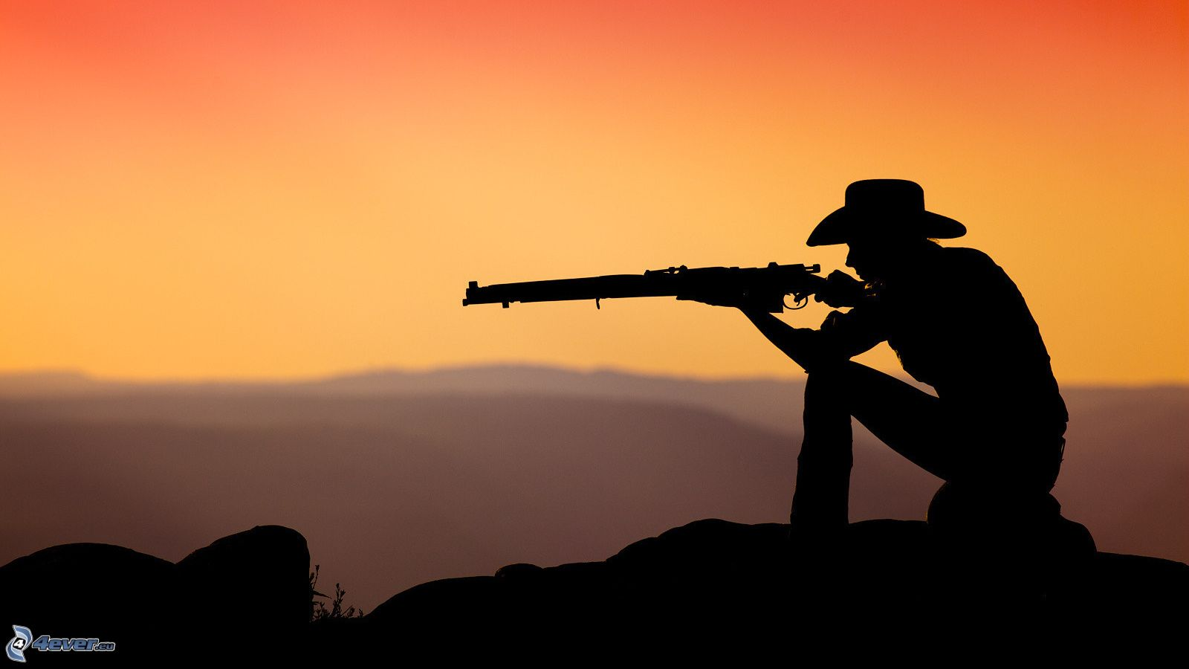
Duel
A quick multiplayer reaction based game
CS370 Industries
Toby Gosselin, Allen Herrera,
Brandon Valyan, Greg Adler
February 26th 2015

Slide 2
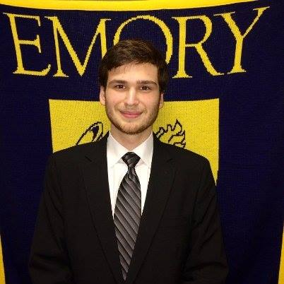



The Team
Toby Gosselin
Allen Herrera
Greg Adler
Brandon Valyan
Project Manager
Developer
Developer
Developer
Presentation Summery
Market Research
Game Description
UI Mockup
Proof of Concept
Conclusion

Slide 3
Market Research
Introduction | Global Markets | Global Positioning | Current Markets | Top Grossing

Slide 4
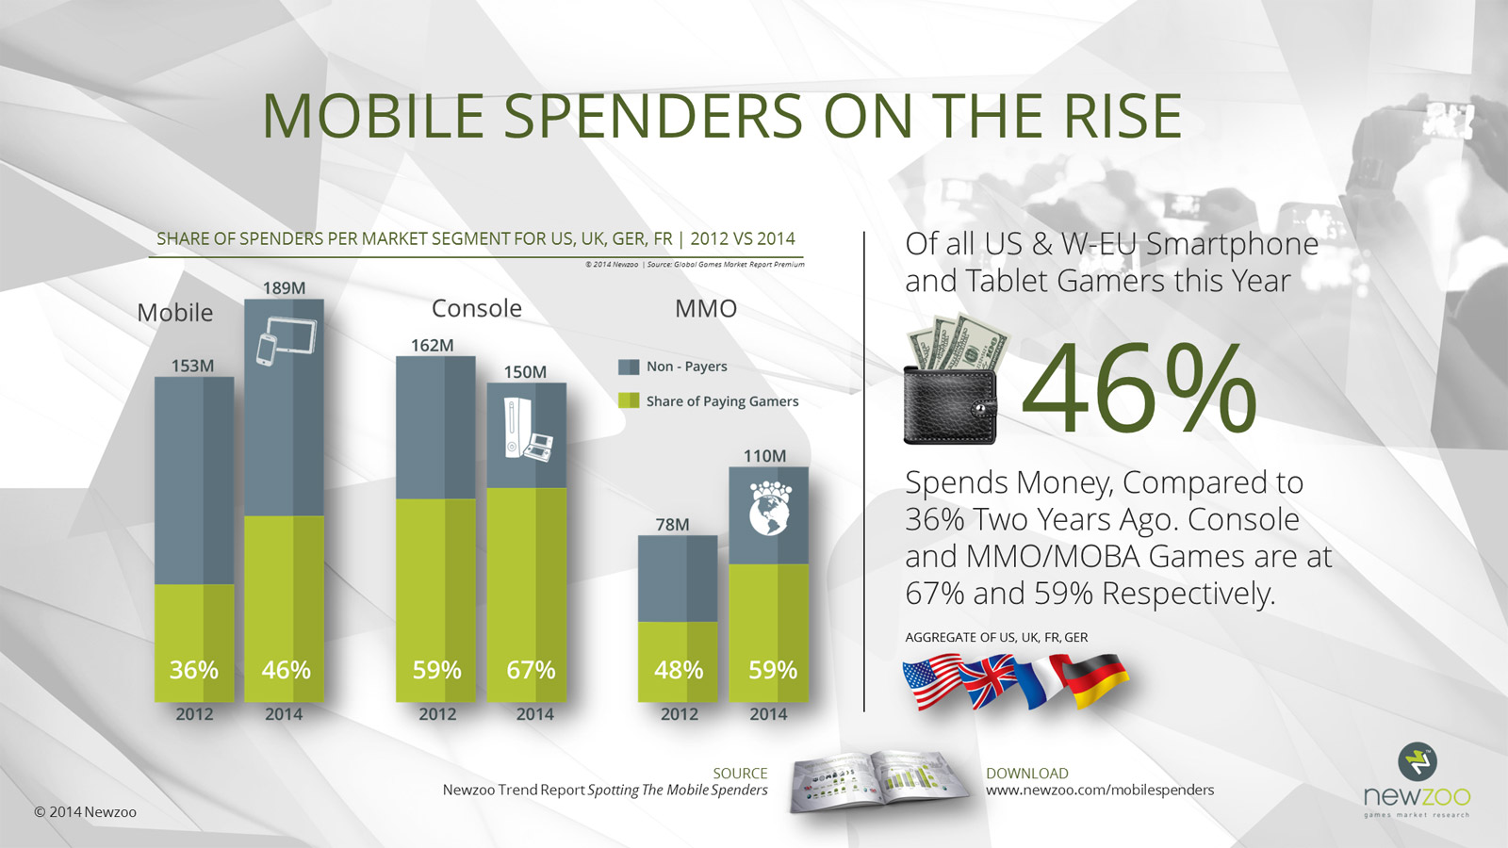
Introduction
Source: Newzoo
Introduction | Global Markets | Global Positioning | Current Markets | Top Grossing

Slide 5
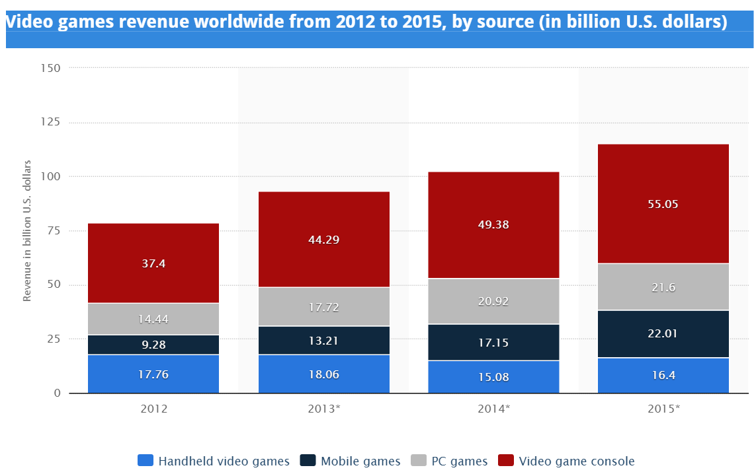
Global Markets
11% -> 19%
Source: Statista
Introduction | Global Markets | Global Positioning | Current Markets | Top Grossing

Slide 6
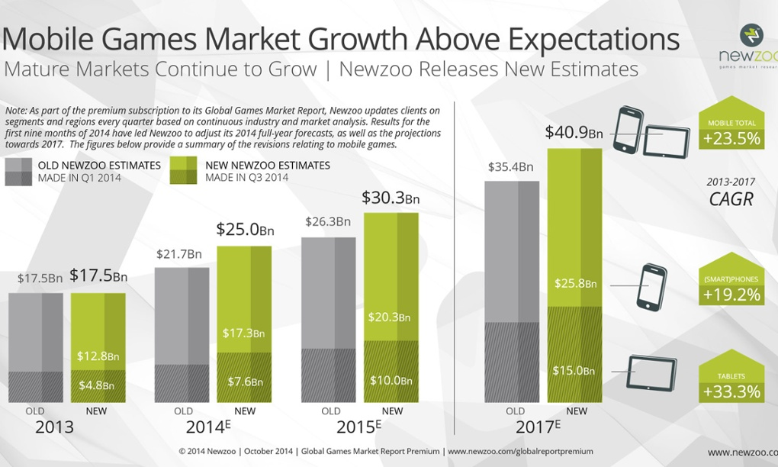
Global Markets
Source: Newzoo
Introduction | Global Markets | Global Positioning | Current Markets | Top Grossing

Slide 7
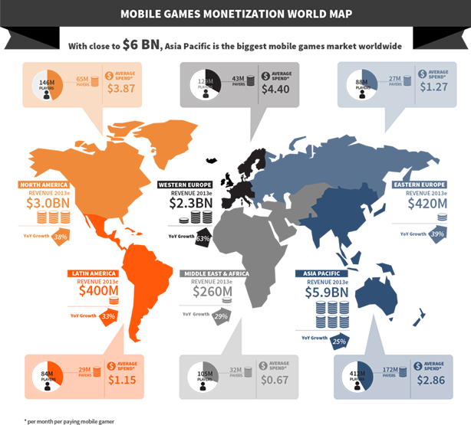
Global Positioning
Source: Newzoo
Introduction | Global Markets | Global Positioning | Current Markets | Top Grossing

Slide 8
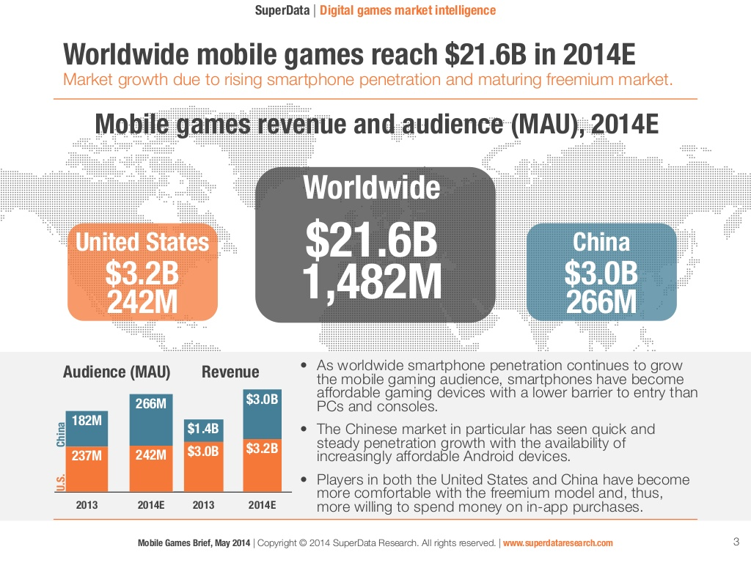
Global Positioning
Source: Superdata
Introduction | Global Markets | Global Positioning | Current Markets | Top Grossing

Slide 9
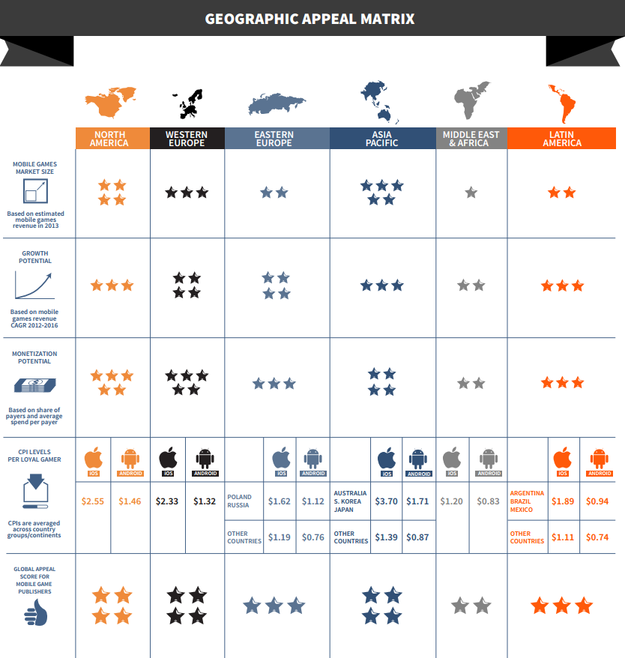
Global Positioning
Source: Superdata
Introduction | Global Markets | Global Positioning | Current Markets | Top Grossing

Slide 10
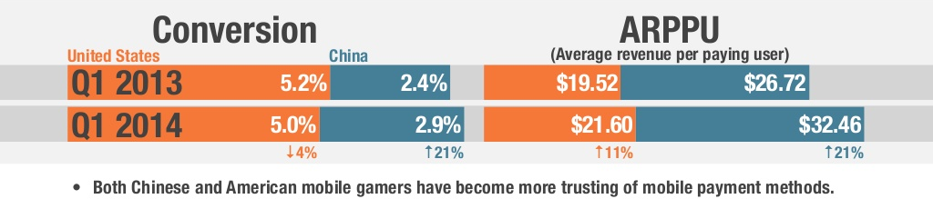
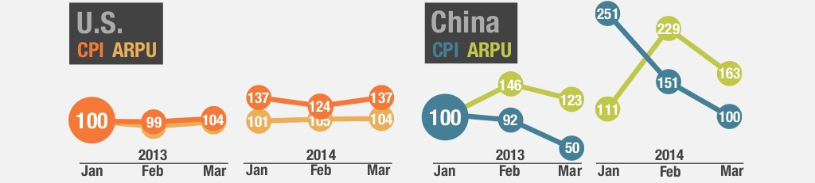
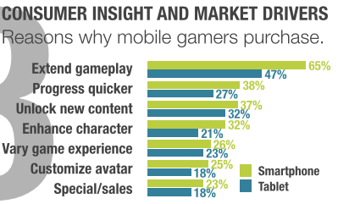
Current Market Conditions
Over 90% of app store revenue in North America comes from in-app purchases
Source: Superdata
Source: Superdata
Average Revenue Per User
North America | Asia
$3.87| $2.86
Source: Superdata
Introduction | Global Markets | Global Positioning | Current Markets | Top Grossing

Slide 11
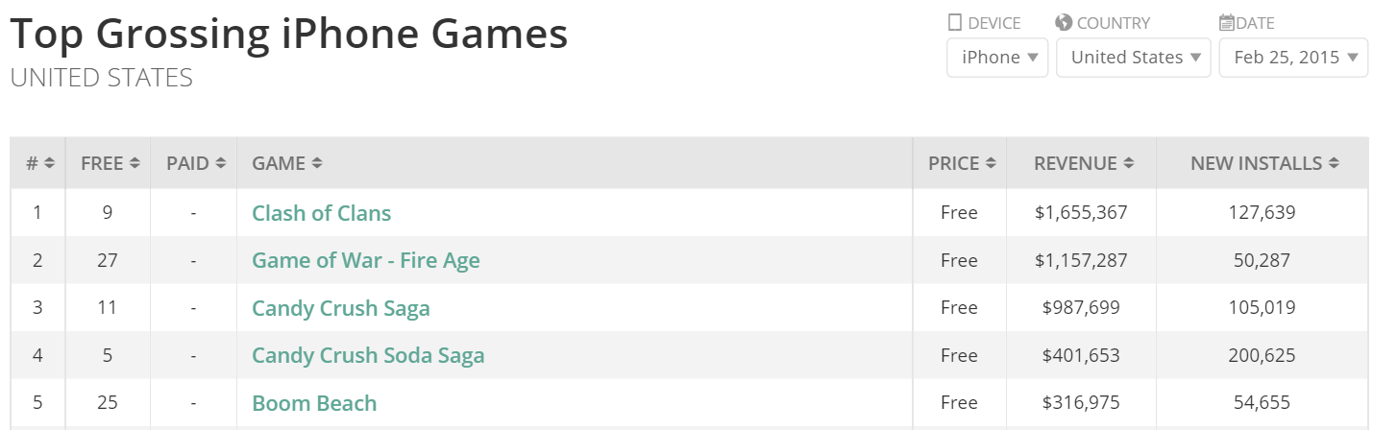
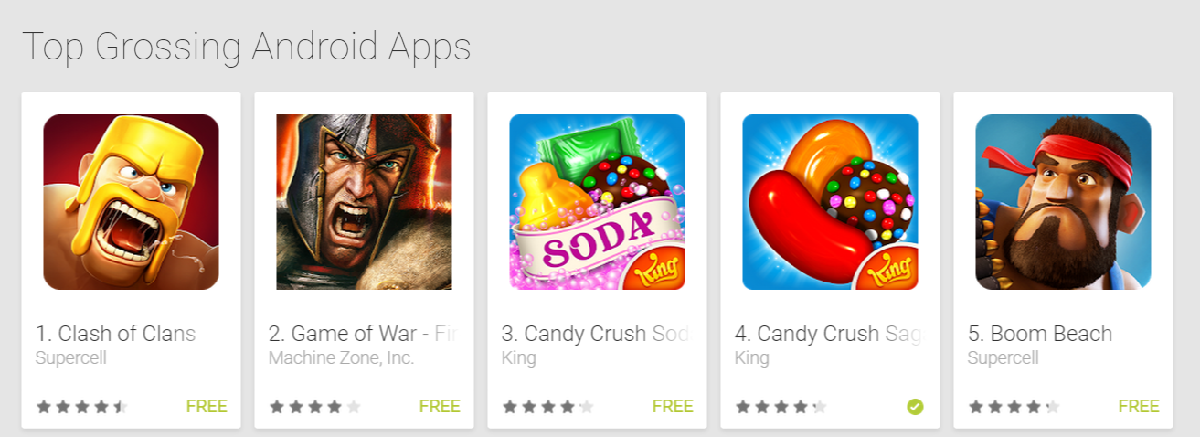
Top Grossing Games
Source: Thinkgaming
Source: Google
Introduction | Global Markets | Global Positioning | Current Markets | Top Grossing

Slide 12
Game Description
Background | User Stories | Feasibility

Slide 13
Background
Duel! is a mobile game where players challenge their friends to a western-themed battle. Each player is given a game code through which they can challenge or be challenged by friends. Once players agree to a duel, players wait for a draw command and the player that clicks first once the command is issued wins. A series of environmental events occur at random meant to distract and intimidate the player.
Background | User Stories | Feasibility

Slide 14
User Stories
As a casual mobile gamer I want to play a fun but simple game with friends so that I can connect with and challenge friends no matter the time window, mobile platform or location.
As an Inviter, I can choose to give out my code to a challenger to duel
As a challenger, I can choose who I battle by entering an Inviter’s code to duel
Background | User Stories | Feasibility

Slide 15
Feasibility
Technology Stack
Responsibilities
Unity Game Engine
Front End
Game Design | UI Design | Backend to Front End Communication
All
Brandon
Toby
Node + Socket.io
Backend
Front End UI | Front End Graphics | Front End Input Handling
Brandon
Toby
Allen
Greg
Team Skills
Programing Skills
Art & Design | Backend | Game Development
Brandon
Toby
Brandon
Allen
Greg
Toby
Brandon
Toby
Background | User Stories | Feasibility

Slide 16
UI Mockup
Mockups

Slide 17
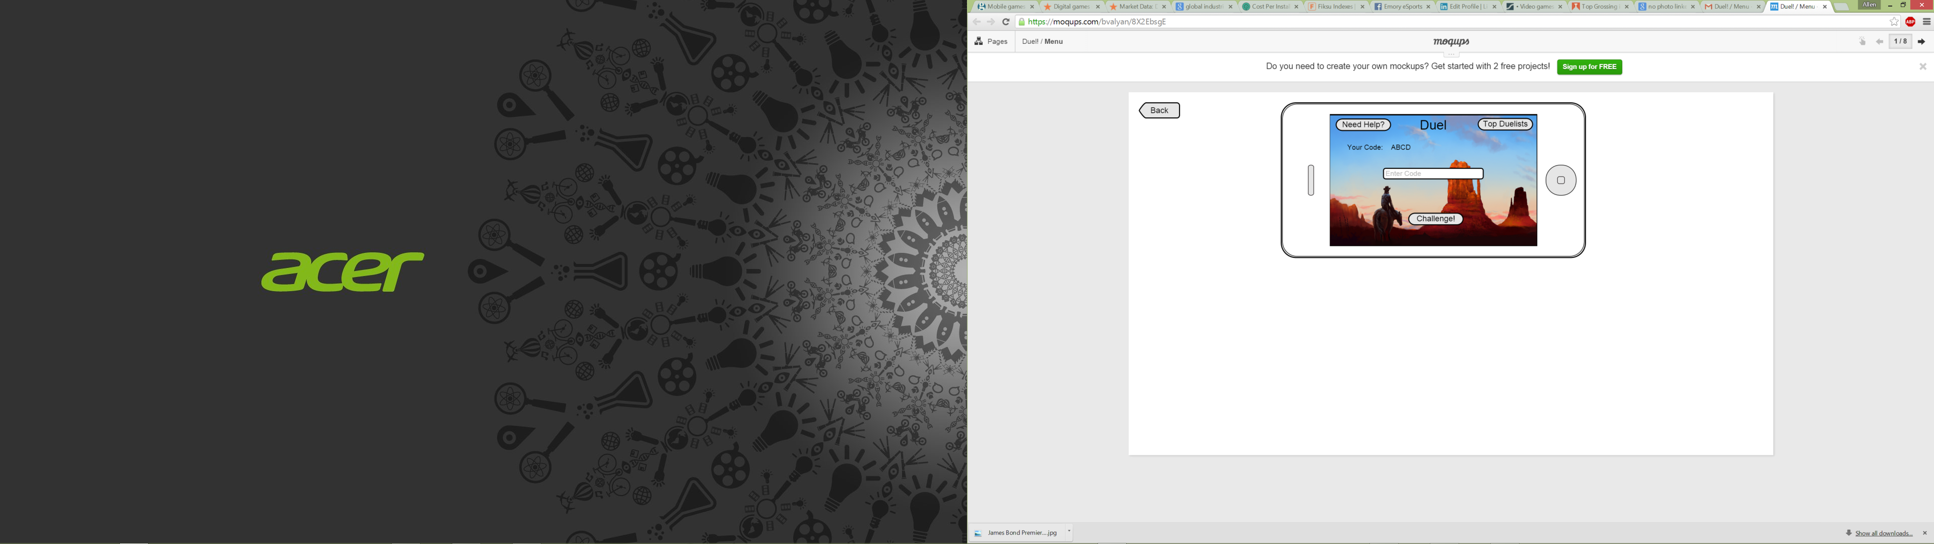
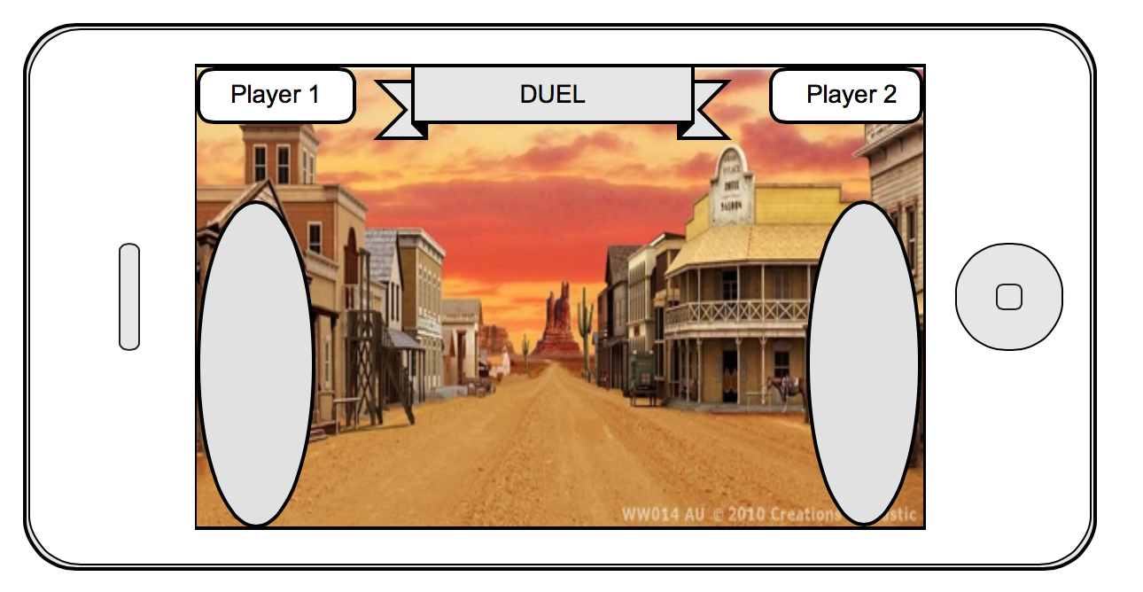
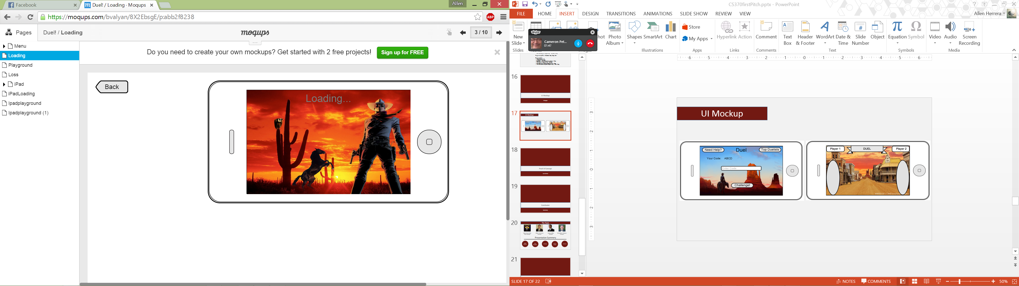
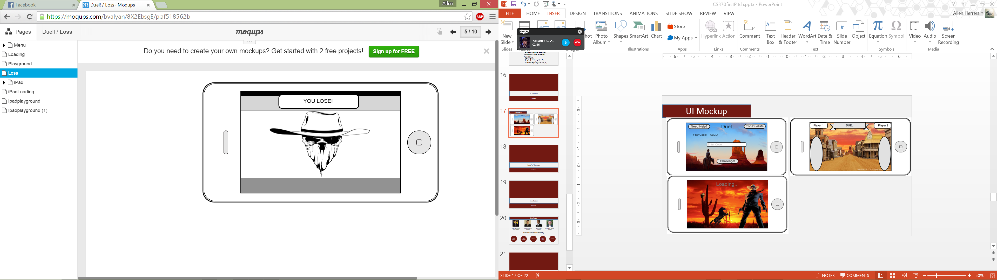
UI Mockup

Slide 18
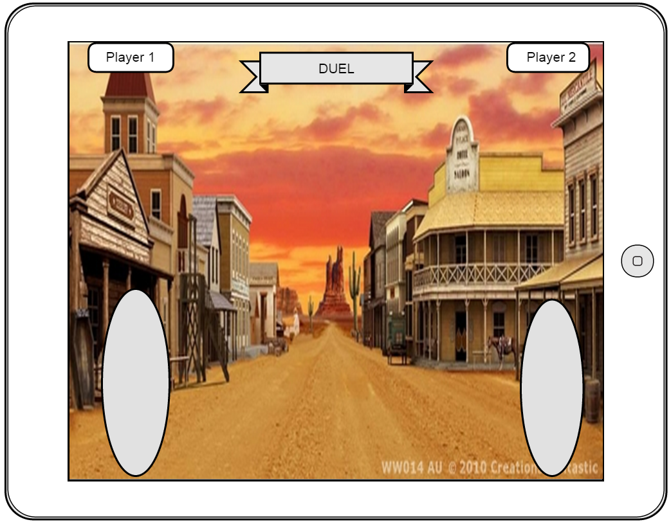
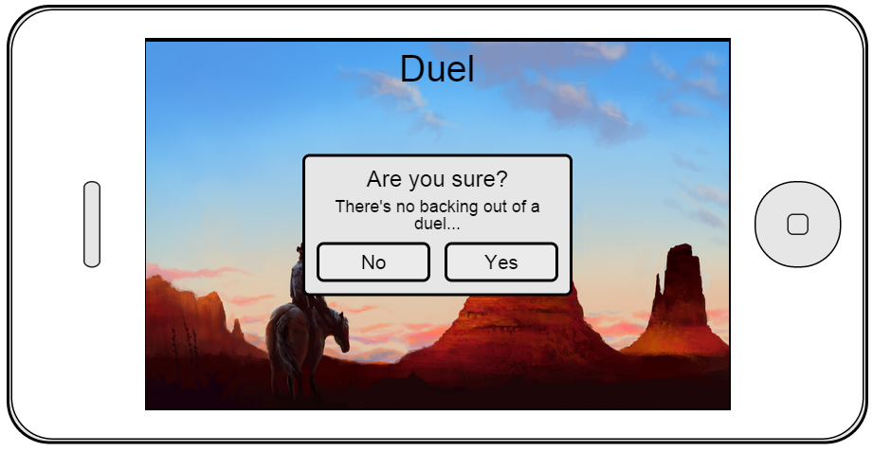
UI Mockup

Slide 19
Proof of Concept
Live Demo | Time Line & Velocity

Slide 20
Time Line & Velocity
Architected Server Client Interaction
Market Research
User Stories created
Mocked up UI
Began Game Design
Finish Game
Deploy production server
Release to app stores
Roll in the dough
Finalize game design
Create assets
Implement Game Play
Brilliant Idea
1 week ago
Yesterday
Near Future
Future

Slide 21
Conclusion
Summary

Slide 22
The Team
Toby Gosselin
Allen Herrera
Greg Adler
Brandon Valyan
Project Manager
Developer
Developer
Developer
Presentation Summery
Market Research
Game Description
UI Mockup
Proof of Concept
Conclusion

Slide 23
Q & A

